Slide 1


Purpose and
Significance Of
Email Writing
kp

Slide 2

Introduction
Email is an integral part of modern communication, used by individuals and businesses alike. It offers a convenient and efficient way to share information, connect with others, and manage tasks.
kp

Slide 3


The Purpose of Email Writing
1
Information Sharing
Collaboration and Teamwork
2
Emails allow for the rapid and widespread dissemination of information, ensuring that everyone has access to the latest updates and announcements.
Emails facilitate communication and collaboration among team members, enabling them to share ideas, discuss projects, and coordinate efforts.
3
4
Requesting and Providing Support
Building Relationships
Emails provide a platform for establishing and nurturing professional relationships, fostering trust and understanding.
Emails offer a convenient way to seek assistance, inquire about specific issues, and offer support to others.

Slide 4
Important components of an Effective Email Writing
Copying individuals on an email is a good way to send your message to the main recipient while also sending someone else a copy at the same time. This can be useful if you want to convey the same exact message to more than one person. In professional settings, copying someone else on an email can help get things done, especially if the person receiving the copy is in a supervisory role.

Slide 5

Crafting Clear and Concise Email Messages
1
Subject lines
Email subject lines are like newspaper headlines. They should convey the main point of your message or the idea that you want the reader to take away. Therefore, be as specific as possible.
2
Salutation
Use greeting and sign-off. Don‘t just start with your text, and don‘t just stop at the end without a polite signature.
3
Proofread Carefully
Review your email for grammatical errors, typos, and inconsistencies before sending.

Slide 6
Important components of an Effective Email Writing
Clear Subject Line
Write the subject line after drafting your message
Use action verbs so the reader knows what you want done
Appeal to the reader‘s needs: ask yourself what will make the reader care about your email
Keep your subject line under 50 characters or 6 to 8 words, so the whole line will show in the in box preview
Keep in mind that some smart phones show only 33 to 44 characters for the subject line
CLEAR SUBJECT LINE

Slide 7
What is the primary purpose of the subject line in an email?
A) To greet the recipient B) To summarize the main content of the email C) To display the sender's name D) To provide the date and time of the email

Slide 8
What is the primary purpose of the subject line in an email?
A)To greet the recipient B) To summarize the main content of the email C) To display the sender's name D) To provide the date and time of the email
Answer: B) To summarize the main content of the email

Slide 9
Important components of an Effective Email Writing
Dear Professor Smith
Hello, Ms. McMahon
Hi, Mary Jane
SALUTATION
(GREETINGS & SIGNOFFS)

Slide 10
Which of the following is the most appropriate salutation for a
formal business email?
A) Hey there! B) Hi [First Name], C) Dear [Title] [Last Name], D) What's up?

Slide 11
Which of the following is the most appropriate salutation for a
formal business email?
A)Hey there! B) Hi [First Name], C) Dear [Title] [Last Name], D) What's up?
Answer: C) Dear [Title] [Last Name]

Slide 12

For your closing, something brief but friendly, or perhaps just your name
Thank you
Best wishes
See you tomorrow
Regards

Slide 13
What is the best way to close a professional email?
A) Later! B) Bye! C) Regards, [Your Name] D) Cheers,

Slide 14
What is the best way to close a professional email?
A)Later! B) Bye! C) Regards, [Your Name] D) Cheers,
Answer: C) Regards, [Your Name]

Slide 15
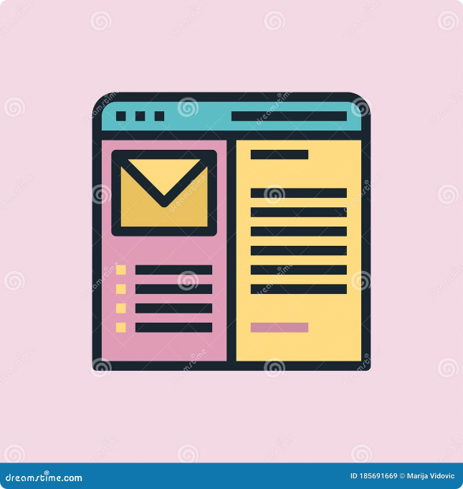
Significance of Email Writing
Improving business reputation
Communicating thoughts and ideas effectively
Providing meaningful correspondence
Avoiding misunderstandings
Saving time
Projecting a professional image
Enhancing credibility
Building and maintaining relationships
Facilitating clear communication
Increasing productivity
Clear Subject Line

Slide 16
How does effective email writing contribute to successful business
communication?
A) It reduces the number of emails sent. B) It enhances understanding and minimizes miscommunication. C) It increases the recipient's workload. D) It allows for more frequent communication.

Slide 17
How does effective email writing contribute to successful business
communication?
A)It reduces the number of emails sent. B) It enhances understanding and minimizes miscommunication. C) It increases the recipient's workload. D) It allows for more frequent communication.
Answer: B) It enhances understanding and minimizes miscommunication.

Slide 18

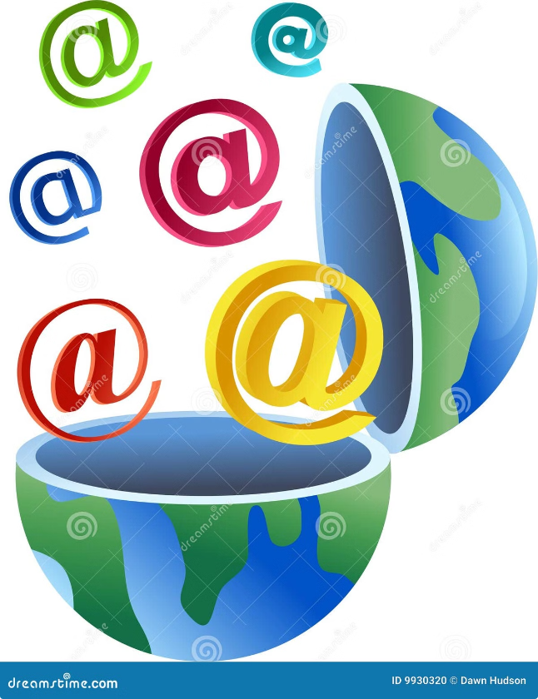
KEY TAKEAWAYS
1. Clear Subject Line
2. Professional Salutation and Tone
3. Concise and Focused Content
4. Proofreading and Editing
5. Proper Use of Attachments
6. Thoughtful Use of CC and BCC
7. Appropriate Closing and Signature
8. Timely Response
9. Mindful Formatting
10. Understanding Your Audience

